Slide 1
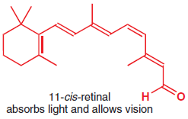
Notes:
Like all sciences, chemistry has a unique place in our pattern of understanding of the
universe.
You are already a highly skilled organic chemist. As you read these words, your eyes are
using an organic compound (retinal) to convert visible light into nerve impulses.

Slide 2
Breaking of sugar molecules
Notes:
When
you picked up this book, your muscles were doing chemical reactions on sugars to give
you the energy you needed.

Slide 3
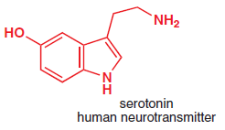
Notes:
As you understand, gaps between your brain cells are being
bridged by simple organic molecules (neurotransmitter amines) so that nerve impulses
can be passed around your brain.

Slide 4
Organic chemistry began as a tentative attempt to understand the chemistry of life. It has
grown into the confi dent basis of worldwide activities that feed, clothe, and cure millions
of people without their even being aware of the role of chemistry in their lives. Chemists
co operate with physicists and mathematicians to understand how molecules behave and
with biologists to understand how interactions between molecules underlie all of life.

Slide 5
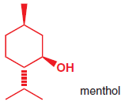

Slide 6
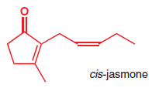

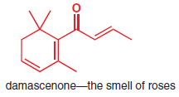


Slide 7
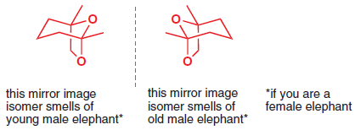

Slide 8
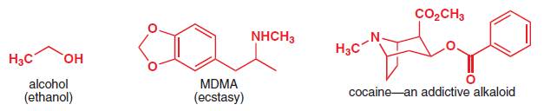
Ecstasy of Life

Slide 9
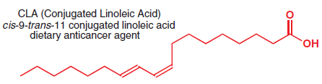

Slide 10
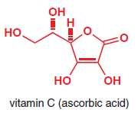

Slide 11
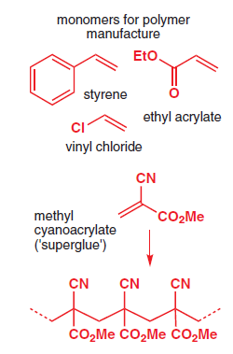

Slide 12
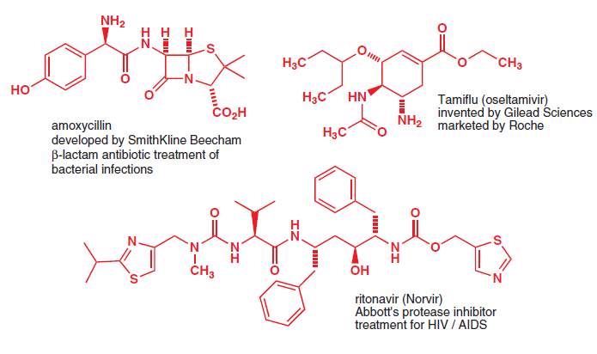

Slide 13
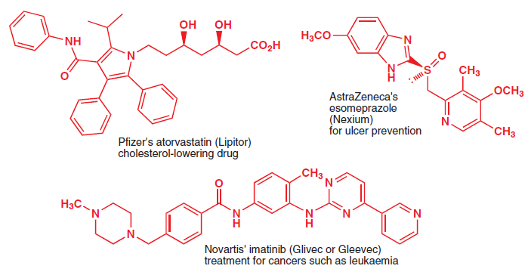

Slide 14
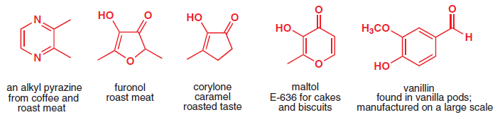

Slide 15
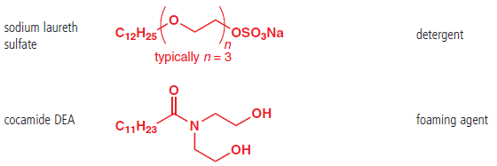


Slide 16
